Slide 1
Flight Delay Prediction
Batch 6
Under the Guidance of
K. N. Sowjanya
Krishna Chaitanya 57
Amruth 46
Surya 52
Aditi Shree 04

Slide 2
Abstract
The primary goal of this project is to predict airline delays caused by various factors. Flight delays lead to negative impacts, mainly economical for commuters, airline industries and airport authorities. Furthermore, in the domain of sustainability, it can even cause environmental harm by the rise in fuel consumption and gas emissions. Hence, these factors indicate how necessary and relevant it has become to predict the delays no matter the wide-range of airline meshes. To carry out the predictive analysis, which encompasses a range of statistical techniques from supervised machine learning and, data mining, that studies current and historical data to make predictions or just analyze about the future delays, with help of Regression Analysis using regularization technique in Python 3.

Slide 3
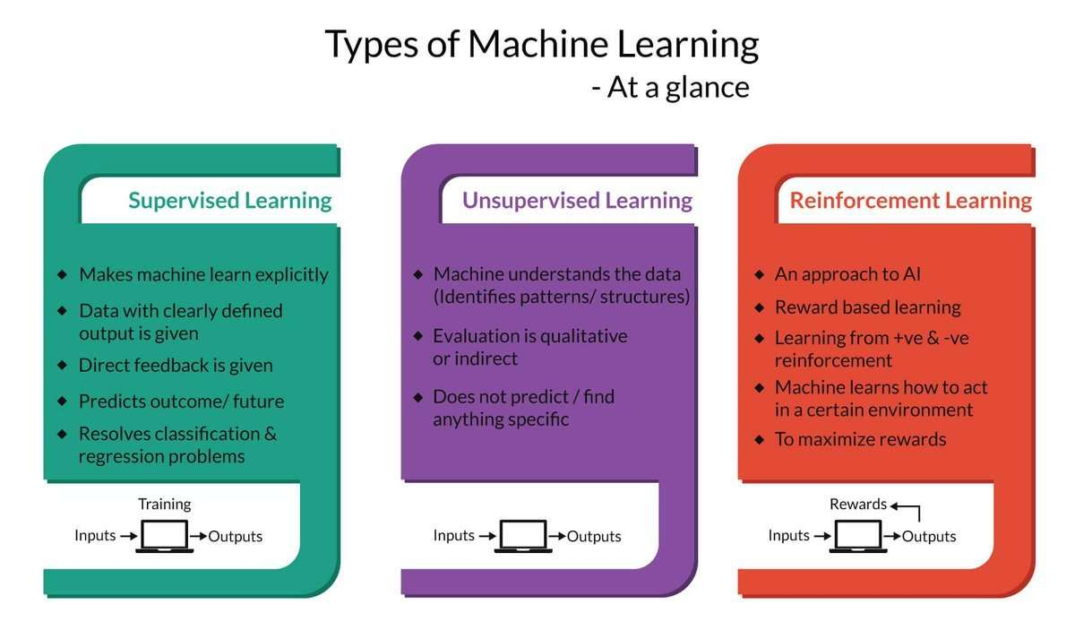
Types of Machine Learning

Slide 4
Literature Survey
Existing Problem
Proposed solution
Over the last twenty years, air travel has been increasingly preferred among travelers, mainly because of its speed and in some cases comfort. This has led to phenomenal growth in the air traffic and on the ground. Increase in air traffic growth has also resulted in massive levels of aircraft delays on the ground and in the air. These delays are responsible for large economic and environmental losses. Moreover, the economic impact of flight delays for domestic flights in the US is estimated to be more than $19 Billion per year to the airlines and over $41 Billion per year to the national economy. In response to growing concerns of fuel emissions and their negative impact on health, there is an active research in the aviation industry for finding techniques to predict flight delays accurately in order to optimize flight operations and minimize delays.
Using machine learning model, we can predict the flight arrival delays. The input to our algorithm is rows of feature vector like departure date, departure delay, distance between the two airports, scheduled arrival time etc. We then use decision tree classifier to predict if the flight arrival will be delayed or not. A flight is considered to be delayed when difference between scheduled and actual arrival times is greater than 15 minutes. Furthermore, we compare decision tree classifier with logistic regression for various figures of merit .Finally, it will be integrated to web based application.

Slide 5
HARDWARE / SOFTWARE SOLUTION
Strategy : Using Application Of Machine Learning Algorithms To Predict Flight Delays
Dataset Creation : Data Collection from Kaggle
Data Visualization : Using different libraries visualize the data in the dataset
Dataset Preprocessing :
Importing general Dataset from Library
Configuring Dataset to Generator class
Training and Testing Dataset : By Applying Dataset Generator Class Functionality

Slide 6
HARDWARE / SOFTWARE SOLUTION
Model Building :
Import Model Building Libraries
Initializing the Model
Loading Preprocessing Data
Adding Machine Learning Algorithms
Configuring Learning Process
Train and Test the Model
Optimize and save the Model
Application Building :
Create HTML file
Build Python Code

Slide 7
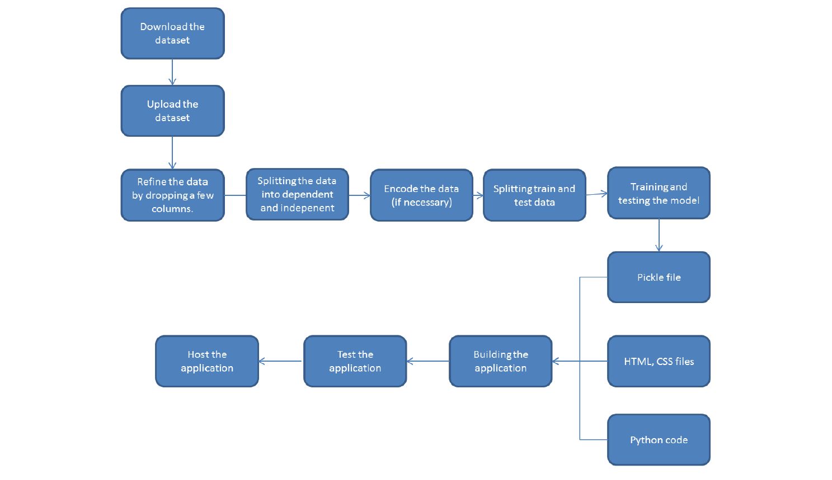
Flowchart

Slide 8
ADVANTAGES AND DISADVANTAGES
Advantages :
Perfect prediction of Risk along with the reason for Delay
Very Accurate Results
Extremely Easy Interface
Straight Forward Results
Disadvantages :
User Should have the idea on inputs

Slide 9
Conclusion
This project and the analysis retrieved are useful not only for passengers point of view, but for every decision maker in the aviation industry. Apart from the financial losses incurred by the industry, flight delay also portray a negative reputation of the airlines, and decreases their reliability. It causes various sustainability issues, for example, increase in fuel consumption and gas emissions. The analysis carried
here not only predicts delays based on the previous available data, but also give statistical description of airlines, their rankings based on their on-time performance, and delays with respect to time, showing the peak hours of delay. This project can be used as a prototype by any aviation authority for their benefit, in the Indian Scenario too, it can work as an efficient model or a proper prototype to study delay analysis, based on the real dataset provided. This project has
encompassed and showed the importance of Regression Analysis in Machine Learning, Data Mining concepts for efficient data cleaning, Cross Validation technique and Regularization in ML for making proper models and its predictive analysis.

Slide 10




Thank you
Krishna Chaitanya 57
Amruth 46
Surya 52
Aditi Shree 04

